Slide 1
Project: Link weight check system FA-SCM-OQC
FA
Pallet ID
SCM
Shipment
- Weight check
- Pro date/Model/Q’ty
- Issue Pallet ID: Model/Q’ty/SN
- Issue Movement slip <SAP>
- Read Pallet ID Model/Q’ty>
- Compare FG & WMS
- Read Pallet: <Model/Q’ty>
- Compare FG & WMS
CURRENT SITUATION
OQC
- Sampling pick up
Additional
Additional
Additional
Additional
REQUEST
① Add OQC :
Input sampling plan
Input Sampling product & Serial No
② Indication OQC situation:
Input Sampling result
Input total judgment All lot.
→ Send result by Email auto
③ QC inspection result:
Reading Pallet ID to check OQC result
Indicate OK lot
④ Function: If OQC judgment NG or Not yet
Stop next step
< PSNV/ Jupiter >
Study to link weight check & WMS
MERIT
Save:
8,000min/month
4000 paper
Save:
Reduce 2pax
990H/year
Save:
4,000 min/month
Note: Model not have S/N → Control as current method

Slide 2
1/1
Project: Link weight check system FA-SCM-OQC
◆Before
◆ After
FA
OQC
SCM
FA
Link
OQC
Link
SCM
. No indicate shipment priority
. No indicate result timely
. Cannot use weight system → compare S/N by manual
. Update OQC result not timely.
. Loss time to come to SCM for chop stamp.
. Loss time to confirm stamp by visual check
. Indicate result timely
. Indicate shipment priority
. Use weight system → auto compare S/N
. Online update OQC result & Save time to come to SCM for chop stamp
. No need check stamp by visual
. Confirm OQC result by system
Target improve:
Prevent wrong packing leakage out to market
△ 2pax for stamp by manual
2pax
OQC Issue
Risky point : Wrong packing pass to market by control offline
Loss time to confirm production result & Shipment schedule : 90sec*150lots=3.75H/day.
2pax/ day need to follow chop stamp in warehouse.
Improvement: Link system from FA-OQC-SCM
Prevent wrong packing.
Save time : 3.75H/day ~ 990H/year
Save manpower : △ 2pax for stamp ~ 12K$/ year

Slide 3

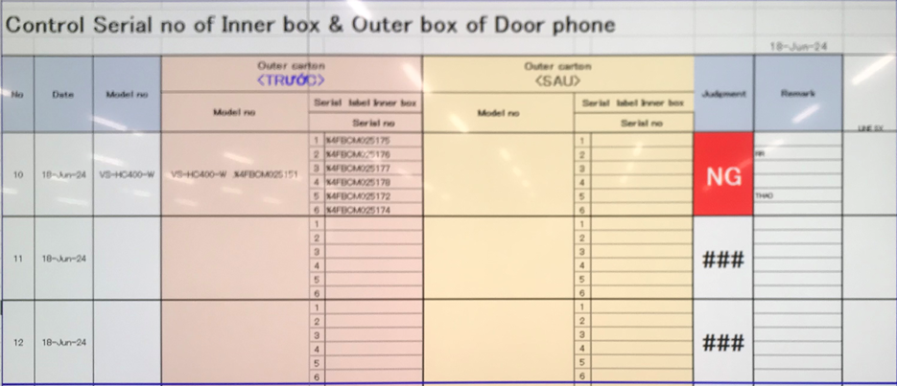
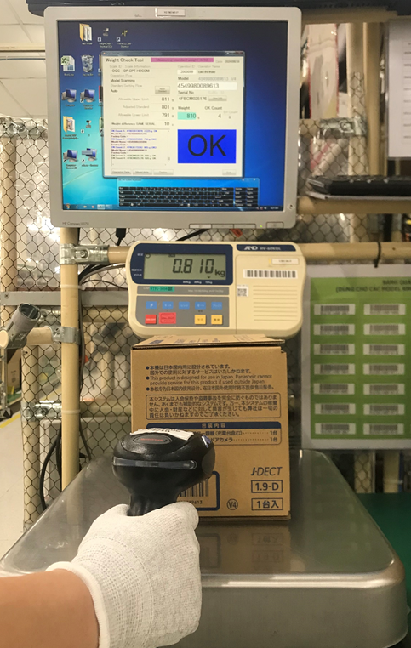
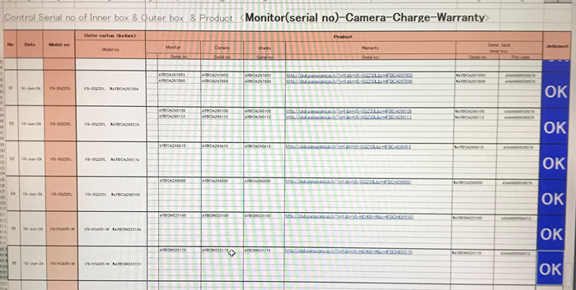
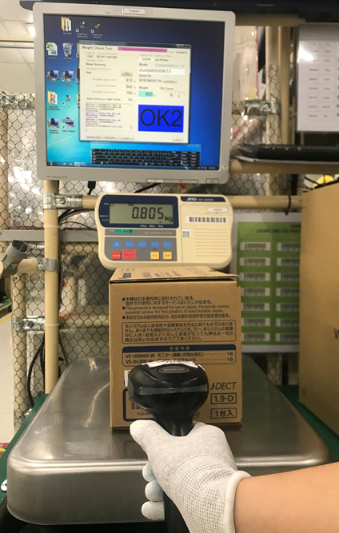
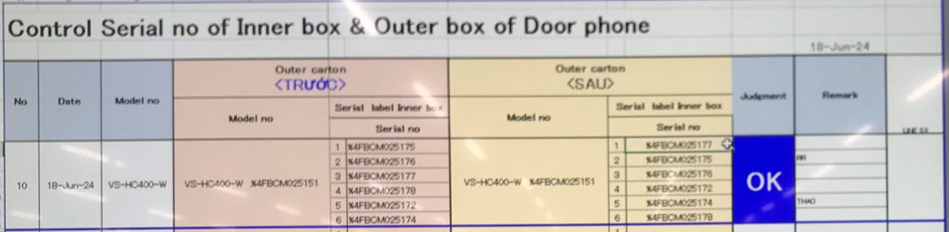
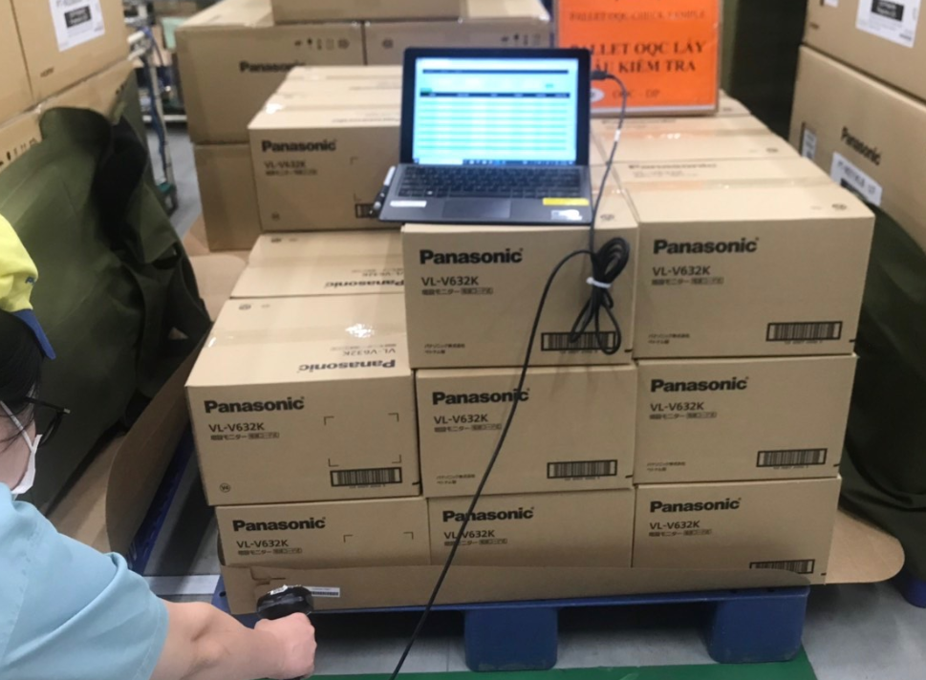
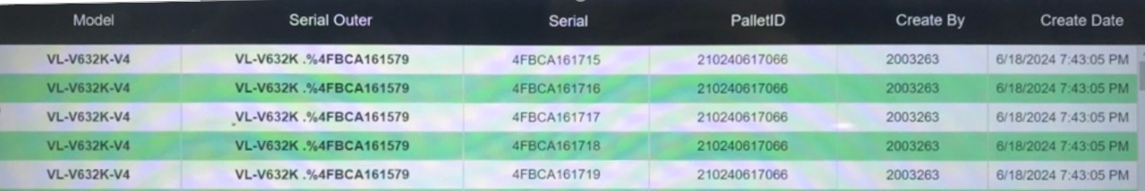
Review OQC pickup sample & chop stamp
Review inspection sample at OQC area
Pick up sample
Reading barcode Inner/Outer
Weight check 1st
OQC Normal
inspection
Reading B/C
Product / Inner
Weight check 2nd
Reading barcode
Inner/Outer
Return to Pallet
Reliability inspection
Confirm S/N Outer & all inner boxes
Accessory control
Numbering control & Separate area
Product / Warranty/ Manual & Inner box
Accessory control
Confirm S/N Outer & all inner boxes
Not link
Not link
Not link
Not link
Not link
Not link
Not link
➔ Current situation: Not link between each process at OQC
Review OQC chop stamp process
OQC find Pallet ID
Matching ID Pallet and Outer Carton
OQC chop stamp all ID Pallet
Read ID Pallet & S/N carton box by excel file
Find all same model, production date, line, shift
Chop stamp on Pallet sheet
OK
DD-MM-YY
OQC
➔ Current situation: Loss time to find pallet to chop stamp

Slide 4
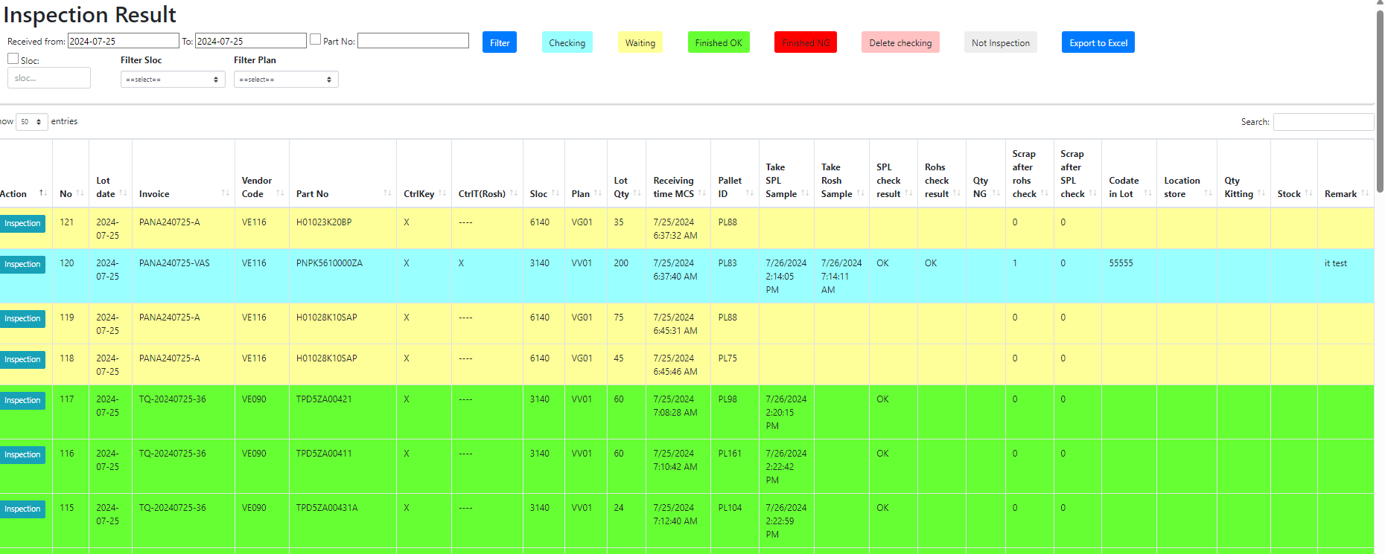
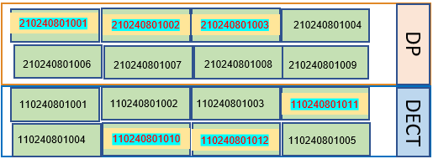
Request item addition
FA confirm
Model | Pro date | Pro line | Plan | Actual | Q'ty pallet | Serial No
VL-SE31KL | 11-Sep-2024 | 2M-K12A | 900 | 500 | 7 | ~
OQC confirm
Model | Ins' date | Sampling check | General check | Pallet OQC chop OK | PL check | Characteristic check | Specfi check | Chamber test | Aging test | Drop test | Vibration test | Final judgment
VL-SE31KL | 11-Sep-2024 | 8 | 5 | 1 | OK | OK | OK | OK | OK | OK | OK | OK
SCM confirm
Model | Inventory Q’ty | Shipment Q’ty | Ship by | Vanning Time | Situation | Final
VL-SE31KL | … | … | Air | … | … | …
New system link FA-SCM-OQC
FA
Link
OQC
Link
SCM
Visualize OQC inspection
Visualize FA Warehouse area

